Slide 1
APPLICATIONS OF COMPUTER GRAPHICS
AUTOCAD

Slide 2
INTRODUCTION TO AUTOCAD
AutoCAD® is computer-aided design (CAD) software that architects, engineers, and construction professionals rely on to create precise 2D and 3D drawings.
Draft, annotate, and design 2D geometry and 3D models with solids, surfaces, and mesh objects
Automate tasks such as comparing drawings, adding blocks, creating schedules, and more.
Autocad includes industry-specific toolsets including Architecture, Electrical, Map 3D, Mechanical, MEP, Plant 3D, and Raster Design, and the AutoCAD web and mobile apps.
For the purpose of this program, the general AutoCAD software will be used for this course.

Slide 3
LAUNCHING AUTOCAD
AutoCAD can be launched by simply double-clicking it from the desktop(i.e. if it was installed using default settings).
Alternatively, AutoCAD can also be launched by going to;
Start -> All Programs -> Autodesk -> AutoCAD 2020 English folder -> AutoCAD 2020 software.
These steps will depend on the type of operating system used for the particular computer.

Slide 4
USER INTERFACE
AutoCAD launches inside an application window which is the new tab as seen in the next slide.
The new tab user interface is made up of two parts; one for learning about AutoCAD and the other for creating drawings.
The create drawing includes the Get Started and Recent Documents
The Get Started tab allows the user to quickly create drawings whiles the recent documents section displays previous drawings if there are any.
The learning tab is a user friendly part that allows connection to Autodesk cloud storage and any other information related to the app.

Slide 5
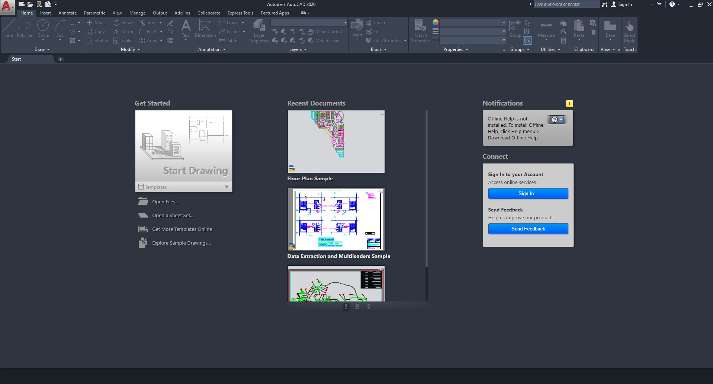
USER INTERFACE
Figure 1: Create Page on the New Tab

Slide 6
INTRODUCING THE WORKSPACES
Clicking on the start drawing tab opens the drafting and annotation workspace as seen in the next slide.
The collection of tools displayed after creating or opening a drawing is called a workspace.
There are three standard workspaces in AutoCAD; Drafting and Annotation, 3D Basics and 3D Modelling.
The drafting and annotation workspace is the default workspace window and it utilizes only 2D tools.

Slide 7
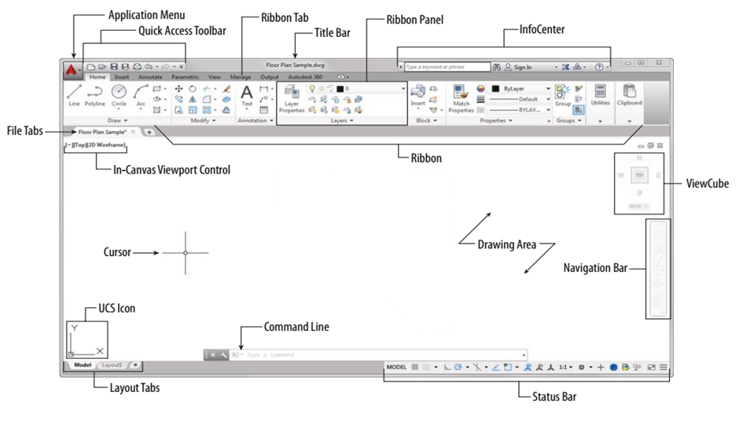
INTRODUCING THE WORKSPACES
Figure 2: Drafting and Annotation Workspace

Slide 8
DRAFTING AND ANNOTATION WORKSPACE
This workspace is the default working area and one which would be used in this course.
As labelled in the previous slide, the workspace contains several commands, bars and windows which would be discussed in the subsequent slides.

Slide 9
DRAFTING AND ANNOTATION WORKSPACE APPLICATION MENU
It is labelled a big red ‘A’ and it contains tools for starting, opening and saving a drawing.
It also contains options such as import and export which allows the user to transfer in or out respectively files and settings from an older AutoCAD version to a newer one.
Files can be exported and imported within other Autodesk products in a specified format.
Publishing files through mails as well as printing out drawings are also options in the application menu.

Slide 10
DRAFTING AND ANNOTATION WORKSPACE QUICK ACCESS TOOLBAR
The quick access toolbar is found just next to the application menu precisely to the right.
It shows the most recently used drawing formatting commands which may include; new, open, save, save as and print.
This toolbar can be customized by a user who wants quick access to such commands.

Slide 11
DRAFTING AND ANNOTATION WORKSPACE TITLE BAR
The title bar just as any other application software is the topmost part of the window.
It displays the name of the application or program as well as the version or year of release. e.g.; Autodesk AutoCAD 2020.
It also displays the title of the current drawing.

Slide 12
DRAFTING AND ANNOTATION WORKSPACE INFOCENTER
It is located at the extreme right on the same bar as the tile bar.
It contains the Search, Autodesk 360, Autodesk Exchange Apps and Help buttons.
You can enter a question in the field to the left of the Search button to access information from a number of locations quickly, including the standard AutoCAD help system through the drop-down panel.
The Autodesk 360 button allows you to sign in with your Autodesk ID and access a wealth of cloud-based services that integrate with AutoCAD.

Slide 13
DRAFTING AND ANNOTATION WORKSPACE RIBBON TAB
It is located just below the title bar and spams across the entire width of the application window.
The Ribbon serves as the primary launch pad for nearly every command used to compose drawings in AutoCAD.
Individual ribbon tabs and their functions would be discussed later on.

Slide 14
DRAFTING AND ANNOTATION WORKSPACE FILE TABS
The file tabs perform the same function as the taskbar in a computer.
Multiple drawings can be opened at a time and the file tab holds every open drawing.
Hence, a user can quickly switch between several drawings by just clicking the name of the file on the tab i.e. if it is opened already.

Slide 15
DRAFTING AND ANNOTATION WORKSPACE IN-CANVAS VIEWPORT CONTROL
It is located in the upper west corner of the drawing area.
There are 3 controls; viewport controls, view controls and visual style controls.
The viewport control by default looks like a minus sign(-) on screen and it provides access to multiple viewport configurations, tools and the display options of the current viewport in a layout.
The view controls by default is the TOP and it provides access to standard and custom views as well as 3D projections.
The visual style controls by default shows 2D wireframe and it provides access to standard and custom visual styles.

Slide 16
DRAFTING AND ANNOTATION WORKSPACE VIEWCUBE
It is found at the upper right corner of the drawing area just below the ribbon tab.
It is primarily used in navigating 3-dimensional drawings.
It provides 26 predefined view orientations.

Slide 17
DRAFTING AND ANNOTATION WORKSPACE COMMAND LINE
AutoCAD presents an interactive feature found beneath the working area called the command line.
It seeks an input from the user to initiate a command as well as displays previously used commands.

Slide 18
DRAFTING AND ANNOTATION WORKSPACE NAVIGATION BAR
It is found just below the view cube although some versions may not place it there.
It contains tools such as full navigation wheel optimized for 3D experience, pan tool for grabbing and moving a drawing around the working area, zoom extents, orbit and show motion.

Slide 19
DRAFTING AND ANNOTATION WORKSPACE LAYOUT TABS
It is found just below the command line and UCS icon on the extreme left.
Each AutoCAD drawing consists of a model tab and any number of layout tabs whose name can be customized.
As a general rule, the model tab represents your design, and the layout tabs represent the piece of paper used to document a design.
The Layout Tab interface allows you to quickly switch between these views of your design.

Slide 20
DRAFTING AND ANNOTATION WORKSPACE UCS ICON
The UCS icon, an essential part of this system, is found in the lower left corner of the drawing area and indicates the positive coordinates for the x-, y-, and z-axes.

Slide 21
DRAFTING AND ANNOTATION WORKSPACE DRAWING AREA AND CURSOR
The blank middle section of the screen is called the drawing area.
This represents a virtually infinite plane. The crosshairs, or cursor as it’s known in AutoCAD, allows you to navigate the drawing area to precisely compose your designs.

Slide 22
DRAFTING AND ANNOTATION WORKSPACE STATUS BAR
It is aligned to the bottom-right corner of the Application window.
Tools located on the status bar are primarily focused on helping you draw and on managing the user interface.

Slide 23
SETTING UP A DRAWING LIMITS
Limits records the coordinates of the lower-left and upper-right corners of the grid and identifies what is displayed when the user executes a Zoom.
The coordinates for the lower-left corner are 0,0 by default and are usually kept at that setting.
Type LIMITS and press enter.
Command line asks to specify lower left corner. Type [0,0] (default)
Command line asks to specify upper right corner. Type [210,297] (A4 sheet size) and click enter.
Now go to the navigation bar and select zoom all from the zoom drop down menu.
The specified A4 sheet will become the only area to be gridded.
Note that the limits used in this illustration above are not the standard and that the limits of a drawing can be any coordinate depending mostly on the size of a drawing

Slide 24
USING THE GRID
The AutoCAD grid, a pattern of horizontal and vertical gridlines that mimic the appearance of a sheet of graph paper, is used as an aid to drawing.
If the grid is not already displayed in the drawing area, move the crosshair cursor to the status bar at the bottom of the screen, and click the Grid Display button.
By default, grid lines are 10mm apart from each other. Right-clicking on the snap mode and choosing settings allows a user to modify the various grid spacing in both the x and y axis.

Slide 25
USING THE GRID
Typing grid in the command line gives options such as [ON OFF Snap Major Adaptive Limits Follow Aspect]
Selecting ON turns on the grids i.e. if they were not already on.
Selecting OFF turns off the grids.
Snap sets the grid spacing to the snap interval specified by the Snap command.
Major specifies the frequency of major lines compared to minor grid lines.
Adaptive controls the density of grid lines when zoomed in or out.
Limits displays the grid beyond the area specified by the limits command.
Follow changes the grid plane to follow the XY plane of the dynamic UCS.
Aspect changes the grid spacing in the X and Y directions, which can have different values.

Slide 26
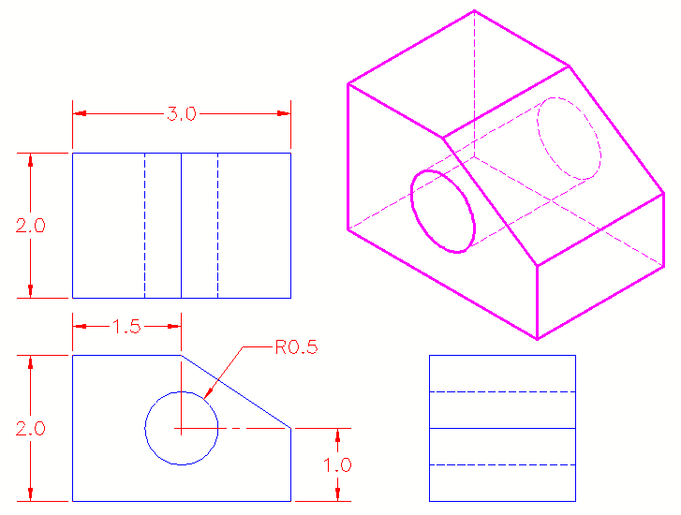
LAYERS

Slide 27
LAYERS
Layer is an organizing tool that allows a user to classify every object in a specific drawing file—lines, arcs, circles, and so on—according to the component of the drawing they represent.
Each layer is assigned a color, and all objects placed on the layer take on that assigned default color unless you specify a different color for the objects.
This lets you easily distinguish between objects that represent separate components of the drawing.
Under a layer, options include; drawing color, line type, line weight, etc.

Slide 28
LAYERS ASSIGNING COLORS TO LAYERS
In the toolbar at the top of the Layer Properties Manager, click the New Layer icon. A new layer named Layer1 appears in the list.
The layer’s name is highlighted, which means you can rename it by entering another name now.
Enter name↵. The row for the layer should still be highlighted.
To open the Select Color dialog box, click the word white in the Color column.
A palette containing colors would appear. Select the preferred color or type the name of the color in the box.

Slide 29
LAYERS ASSIGNING LINETYPES TO LAYERS
Once the newly created layer is still highlighted, click on the line type to show a list of loaded line types.
If preferred line type is not in the list, click on load to reveal list of all line types.
The selected line type will then be added to the list of line types. Now select the line and click on okay.

Slide 30
BASIC COMMANDS LINE
Line tool is the first command to explore under the home tab.
The LINE command draws a straight-line segment between locations on existing objects, geometric features, or two points that you can choose anywhere within the drawing area.
Typing line in the command line will slightly change the cursor to a straight crosshair and ask;
Specify first point:
Left-clicking in the working area and moving the cursor away produces a line segment that stretches as the cursor is moved away. The next command in the command line says;
Specify next point or [Undo]:
Clicking once more ends the line segment and begins another which again asks for the same command;
Specify next point or [Undo]:

Slide 31
COORDINATE SYSTEMS
Users may have realized the command line asks to specify points especially when starting to draw using a tool.
Aside clicking in the command window to start drawing, one can supply a pair of coordinates that shows where to begin drawing and where to end.
There are 3 coordinate systems used in AutoCAD; absolute, relative and polar.

Slide 32
ABSOLUTE COORDINATE SYTEM
This is the default system which assumes every coordinate from the origin.
When drawing lines, AutoCAD is ready to place the next vertex wherever you tell it to go.
Type L on the command line and press enter.
Type 4,6 on the command line and press enter.
Type 5,3 on the command line and press enter.
Press enter to finish the Line command.

Slide 33
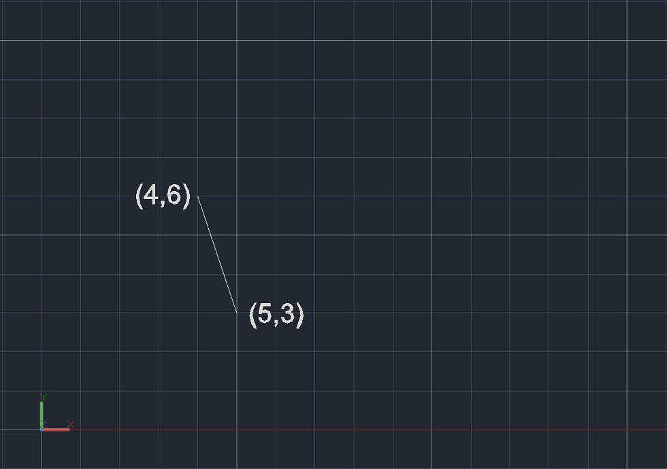
ABSOLUTE COORDINATE SYTEM
AutoCAD draws a line starting at coordinate [4,6] and ending at [5,3].
It made a segment between those two points. The first point is 4 to the right and 6 up from the origin.
The second point is 5 to the right and 3 up from the origin.
The line is the shortest distance between those two points.

Slide 34
RELATIVE COORDINATE SYSTEM
This system does not start entry from the origin instead the next point is drawn with respect to the previous point.
Type L on the command line and press enter.
Type 4,6 on the command line and press enter.
Type @5,3 on the command line and press enter.
Press enter to finish the line command.
AutoCAD recognizes the @ symbol as instructions to count using relative coordinates.

Slide 35
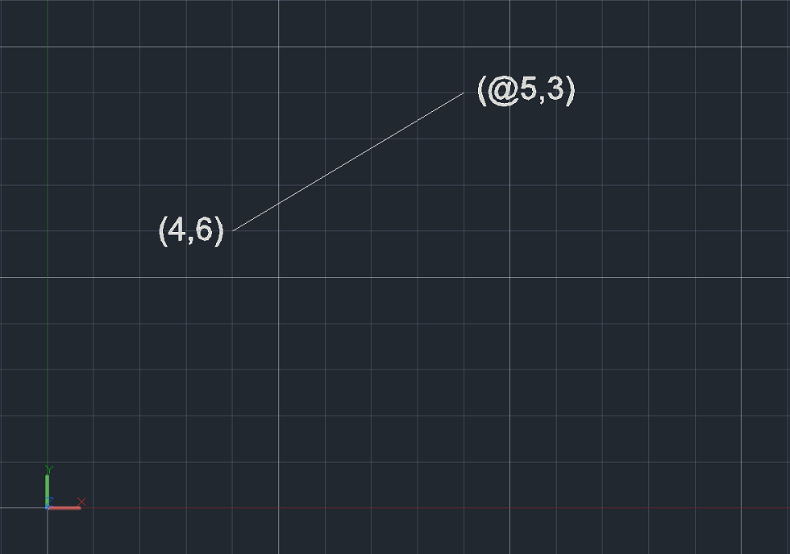
RELATIVE COORDINATE SYSTEM
While both lines made thus far started at the same point, this time, for the second vertex, AutoCAD counted 5 over and 3 up from the first vertex, and made the line between those two locales.

Slide 36
POLAR COORDINATE SYSTEM
Polar coordinates employ one radial distance and one angle (by convention, the angle is measured counterclockwise from the x-axis). The angle signifies the direction, and the distance is how far to go in that direction from the pole.
Polar coordinates in AutoCAD are given as R<Degrees, where:
“R” is the radial distance.
“<” is the less than sign (but in this case represents the angle).
“Degrees” is the value of the angle in degrees.
Like Cartesian coordinates, polar coordinates are employed as a subcommand.
The analogue to ORTHO mode is POLAR tracking (F10). Polar tracking restricts cursor movement to specified angles.
The user can specify the acceptable angle increments by right-clicking the icon.

Slide 37
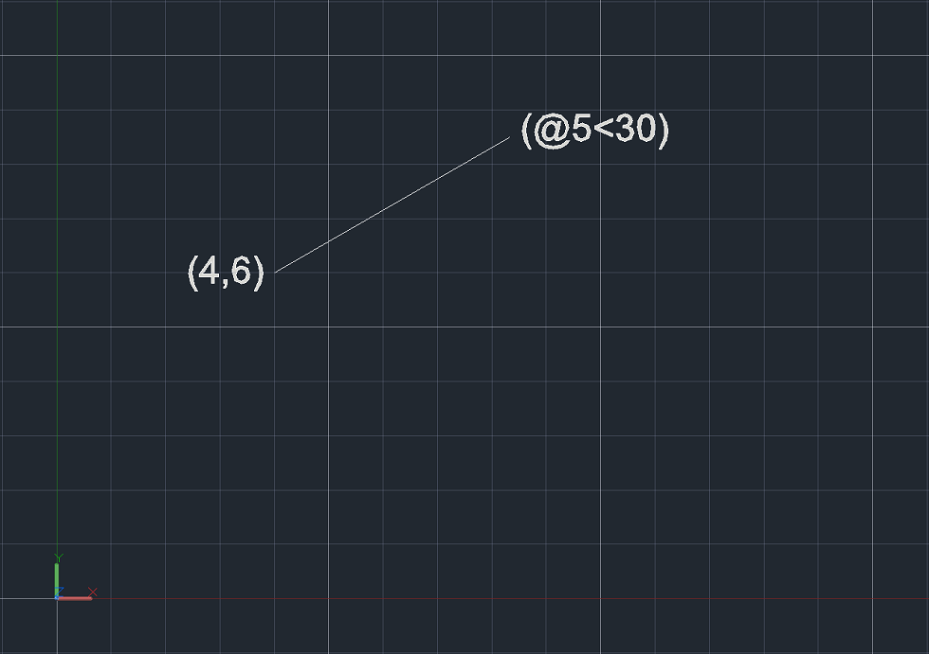
POLAR COORDINATE SYSTEM
Relative coordinates also work with polar input.
Type L on the command line and press enter.
Type 4,6 on the command line and press enter.
Type @5<60 on the command line and press enter.
Press enter to finish the line command.
The above line started at 4,6 (which is input in absolute Cartesian coordinates). Since the next line had the @ symbol, that means the previous point (4,6), became the pole, or reference point for the relative coordinates.
We input the polar coordinates as @5<60, which means the length of the line is 5 and the angle counterclockwise from the x-axis is 60 degrees.

Slide 38
BASIC COMMANDS CIRCLE
The circle tool is used to draw a round plane figure whose boundary consists of points equidistant from a fixed point(the center).
There are 6 methods for drawing a circle in AutoCAD; center radius(default method), center diameter, 2-point, 3-point, tan-tan-radius, tan-tan-tan.
The center radius method requires a user to specify the center point and radius of the circle.
The center diameter method requires a center point and a diameter for a circle.
The 2-point method creates a circle based on two endpoints of the diameter.
The 3-point method creates a circle based on three points on the circumference.
The tan-tan-radius method creates a circle with a specified radius and tangent to two objects.
The tan-tan-tan method creates a circle with tangent to three objects.

Slide 39
BASIC COMMANDS POLYLINE
The polyline command allows the user to create a single object using a sequence of connected line segments.
Line segments, arc segments or a combination of both can be created at a go.

Slide 40
ARC
To create an arc, you can specify combinations of center, endpoint, start point, radius, angle, chord length, and direction values. Arcs are drawn in a counterclockwise direction by default. Hold down the Ctrl key as you drag to draw in a clockwise direction.
Start point;
Draws an arc using three specified points on the arc's circumference. The first point is the start point (1).
Note: If you press ENTER without specifying a point, the endpoint of the last drawn line or arc is used and you are immediately prompted to specify the endpoint of the new arc. This creates an arc tangent to the last drawn line, arc, or polyline.

Slide 41

ARC START POINT
Start point
Draws an arc using three specified points on the arc's circumference. The first point is the start point (1).
Note: If you press ENTER without specifying a point, the endpoint of the last drawn line or arc is used and you are immediately prompted to specify the endpoint of the new arc. This creates an arc tangent to the last drawn line, arc, or polyline.
Second point
Specify the second point (2) is a point on the circumference of the arc.
End point
Specify the final point (3) on the arc.

Slide 42

ARC CENTER POINT
Starts by specifying the center of the circle of which the arc is a part.
Start point
Specify the start point of the arc.
End point
Using the center point (2), draws an arc counterclockwise from the start point (1) to an endpoint that falls on an imaginary ray drawn from the center point through the third point (3).

Slide 43

ARC END POINT
Starts by specifying the endpoint of the arc.
Center point
Draws an arc counterclockwise from the start point (1) to an endpoint that falls on an imaginary ray drawn from the center point (3) through the second point specified (2).

Slide 44
RECTANGLE AND POLYGON
By Length and Width
Click Home tab > Draw panel > Rectangle. Find
Specify the first corner of the rectangle.
Enter D for Dimensions.
Enter the length.
Enter the width.
Specify the other corner.
Note: You are restricted by the length and width values.

Slide 45
RECTANGLE AND POLYGON
By Area
Click Home tab > Draw panel > Rectangle. Find
Specify the first corner of the rectangle.
Enter A for Area.
Enter the area.
Do one of the following:
Enter L to enter the length. The width is calculated based on the length and the area.
Enter W to enter the width. The length is calculated based on the width and the area.
Enter the value for the length or width.

Slide 46
RECTANGLE AND POLYGON
With Rotation
Click Home tab > Draw panel > Rectangle. Find
Specify the first corner of the rectangle.
Enter R for Rotation.
Enter the rotation value or enter P to pick two points to define the angle of rotation.
Specify the other corner.

Slide 47
POLYGON
Creates an equilateral closed polyline.
You specify the number of sides of the polygon and whether it is inscribed or circumscribed.
Number of sides
Specifies the number of sides in the polygon (3-1024).
Center of polygon
Specifies the location of the center of the polygon and whether the new object is inscribed or circumscribed.
Inscribed in circle
Specifies the radius of a circle on which all vertices of the polygon lie.
Specifying the radius with your pointing device determines the rotation and size of the polygon. Specifying the radius with a value draws the bottom edge of the polygon at the current snap rotation angle.

Slide 48
POLYGON
Circumscribed about circle
Specifies the distance from the center of the polygon to the midpoints of the edges of the polygon.
Specifying the radius with your pointing device determines the rotation and size of the polygon. Specifying the radius with a value draws the bottom edge of the polygon at the current snap rotation angle.
Edge
Defines a polygon by specifying the endpoints of the first edge.

Slide 49
HATCH
Fills an enclosed area or selected objects with a hatch pattern, solid fill, or gradient fill.
Choose from several methods to specify the boundaries of a hatch.
Specify a point in an area that is enclosed by objects.
Select objects that enclose an area.
Specify boundary points using the -HATCH Draw option.
Drag a hatch pattern into an enclosed area from a tool palette or Design Center.

Slide 50
HATCH
Pick internal point
Determines a boundary from existing objects that form an enclosed area around the specified point.
Select objects
Determines a boundary from selected objects that form an enclosed area.
Remove boundaries
(Available only when adding hatches from within the Hatch and Gradient dialog box)
Removes the hatch patterns added during the currently active HATCH command. Click the pattern you want to remove.
Add boundaries
(Available only when adding hatches from within the Hatch and Gradient dialog box)
Switches from the Remove Boundaries mode so you can add hatch patterns again.
Undo
Removes the last hatch pattern you inserted with the currently active HATCH command.
Settings
Opens the Hatch and Gradient dialog box, where you can change settings.

Slide 51
MOVE
Moves objects a specified distance in a specified direction.
The following prompts are displayed.
Select objects
Specifies which objects to move.
Base point
Specifies the start point for the move.
Second point
In combination with the first point, specifies a vector that indicates how far, and in what direction, the selected objects are moved.

Slide 52
COPY
Copies objects a specified distance in a specified direction.
The following prompts are displayed.
Select objects: Use an object selection method and press Enter when you finish.
Specify base point or [Displacement/mode/Multiple] <Displacement>: Specify a base point or enter an option.
Specify second point or [Array] <use first point as displacement>: Specify a second point or enter an option.
Displacement
Specifies a relative distance and direction using coordinates.
Mode
Controls whether the command repeats automatically (COPYMODE system variable).

Slide 53
COPY
Array
Arranges a specified number of copies in a linear array.
Fit
Redefines the array to use the specified displacement as the location of the last copy rather than the first copy, fitting the other copies between the original selection set and the final copy.

Slide 54
ROTATE
Rotates objects around a base point.
The following prompts are displayed:
Select objects
Use an object selection method and press Enter when you finish.
Specify base point
Specify a point.
Specify rotation angle
Enter an angle, specify a point, enter c , or enter r.
Rotation Angle. Determines how far an object rotates around the base point. The axis of rotation passes through the specified base point and is parallel to the Z axis of the current UCS.
Copy. Creates a copy of the selected objects for rotation.
Reference. Rotates objects from a specified angle to a new, absolute angle. When you rotate a viewport object, the borders of the viewport remain parallel to the edges of the drawing area.

Slide 55
MIRROR
Creates a mirrored copy of selected objects.
The following prompts are displayed.
Select objects
Use an object selection method to select the objects to be mirrored. Press Enter to finish.
Specify first point, second point of mirror line.
Erase source objects
Determines whether the original objects are erased or retained after mirroring them.

Slide 56
STRETCH
Stretches objects crossed by a selection window or polygon.
Objects that are partially enclosed by a crossing window are stretched. Objects that are completely enclosed within the crossing window, or that are selected individually, are moved rather than stretched. Some types of objects such as circles, ellipses, and blocks, cannot be stretched.
Select objects
Specifies the portion of the object that you want to stretch.
Base Point
Specifies the base point from which the offset for the stretch is calculated. This base point can be outside the area being stretched.

Slide 57
SCALE
Enlarges or reduces selected objects, keeping the proportions of the object the same after scaling.
To scale an object, specify a base point and a scale factor. The base point acts as the center of the scaling operation and remains stationary. A scale factor greater than 1 enlarges the object. A scale factor between 0 and 1 shrinks the object.
The following prompts are displayed.
Select objects
Specifies which objects you want to resize.
Base point
Specify a base point for the scale operation.

Slide 58
SCALE
Scale Factor
Multiplies the dimensions of the selected objects by the specified scale. A scale factor greater than 1 enlarges the objects. A scale factor between 0 and 1 shrinks the objects.
Copy
Creates a copy of the selected objects for scaling.
Reference
Scales the selected objects based on a reference length and a specified new length.

Slide 59
TRIM
Trims objects to meet the edges of other objects.
Standard Mode. To trim objects, first select the boundaries and press Enter. Then select the objects to be trimmed. To use all objects as boundaries, press Enter at the first Select Objects prompt.
Quick Mode. To trim objects, select the objects to be trimmed individually, press and drag to start a freehand selection path, or pick two empty locations to specify a crossing Fence. All objects automatically act as cutting edges. Selected objects that can't be trimmed are deleted instead.

Slide 60
FILLET
Rounds and fillets the edges of objects.
The following prompts are displayed.
First Object
Selects the first of two objects required to define a 2D fillet.
Undo
Reverses the previous action in the command.
Polyline
Inserts fillet arcs at each vertex of a 2D polyline where two line segments meet.

Slide 61
FILLET
Radius
Defines the radius of the fillet arc.
The value you enter becomes the current radius for subsequent FILLET commands. Changing this value does not affect existing fillet arcs.
Trim
Controls whether FILLET trims the selected edges to the fillet arc endpoints.
Multiple
Rounds the edges of more than one set of objects.
Edge
Selects a single edge. You can continue to select single edges until you press Enter.

Slide 62
EXPLODE
Breaks a compound object into its component objects.
Explodes a compound object when you want to modify its components separately. Objects that can be exploded include blocks, polylines, and regions, among others.

Slide 63
ARRAY
You can create copies of selected objects to be arranged in a pattern called an array.
After you select the objects that you want to duplicate, which are called the source objects, you choose the arrangement pattern. There are three types of arrays:
Rectangular
Path
Polar

Slide 64
OFFSET
Creates concentric circles, parallel lines, and parallel curves.
Offset Distance
Creates an object at a specified distance from an existing object.
Multiple
Enters the Multiple offset mode, which repeats the offset operation using the current offset distance.

